Slide 1
Name: R.kamalesh
Regno: 20324u48014
NMID : 1D1281CDC222991A2794BE597765A0CC
Department : data science
College /university: Dr. M.g.r. Chockalingam arts college /Thiruvalluvar university

Slide 2
Project overview
1. Introduction – A short background about what the project is about. 2. Objectives – What you want to achieve. 3. Scope – What the project will cover and not cover. 4. Methodology/Approach – How the project will be carried out.

Slide 3
5. Expected Outcomes – What results you expect at the end. 6. Timeline – Duration or phases of the project. 7. Team/Stakeholders – People involved in the project.
(e.g., “music website,” “event management system,” “business plan,” etc.),

Slide 4
Who are the end users?
End users are the people who ultimately use a product, service, or system. They are the final consumers who interact directly with what has been created, rather than those who design, develop, or distribute itFor example: In software → End users are the people who install and use the application on their devices. In a website → The visitors who browse, register, or perform actions on the site. End users are the people who ultimately use a product, service, or system. They are the final consumers who interact directly with what has been created, rather than those who design, develop, or distribute it. In a product → The customer who actually uses the item, not just the one who sells or manufactures it.

Slide 5
Tools and technologies
🔹 What are Tools and Technologies? Tools → Software, platforms, or applications that help in performing specific tasks (e.g., Microsoft Word for documentation, Git for version control). Technologies → The methods, frameworks, programming languages, or systems used to build, manage, or operate solutions (e.g., Artificial Intelligence, Cloud Computing, HTML, Java).

Slide 6
Portfolio and design and layout
🔹 Essential Sections for a Portfolio 1. Header / Intro Name or Brand Logo Short tagline (e.g., “UI/UX Designer | Front-End Developer | Creative Thinker”) Profile photo or hero illustration

Slide 7
2. About Me Brief bio (who you are, what you do, what makes you unique) Skills and expertise (use icons, progress bars, or clean lists)

Slide 8
3. Projects / Work Samples Featured projects with thumbnails Each project card should include: Title Short description (problem, solution, tools used) Visuals (screenshots, mockups, links, demos)

Slide 9
Features and functionality
Features of a Portfolio Website 1. Home Page – Brief introduction and highlights. 2. About Section – Personal/professional background. 3. Portfolio/Projects Showcase – Images, descriptions, links, case studies.

Slide 10
4. Contact Form – Easy way to reach out 5. Resume/CV Download – Option to view or download. 6. Testimonials/Recommendations – Feedback from clients or peers. 7. Blog/Articles (Optional) – Share thoughts, experiences, or tutorials.

Slide 11
Functionality Responsive Design – Works on desktop, tablet, and mobile. Interactive UI – Smooth navigation, animations, hover effects. Search/Filter Projects – Sort projects by category/technology. SEO Optimization – Improves visibility in search engines. Social Media Integration – Links to LinkedIn, GitHub, etc.

Slide 12
Results and screenshots
Can you clarify what you want the results and screenshots for? Do you mean results & screenshots of a website project (like the music website or event website you asked earlier)? Or do you need outputs and screenshots of code execution (HTML page output, tools, etc.)

Slide 13
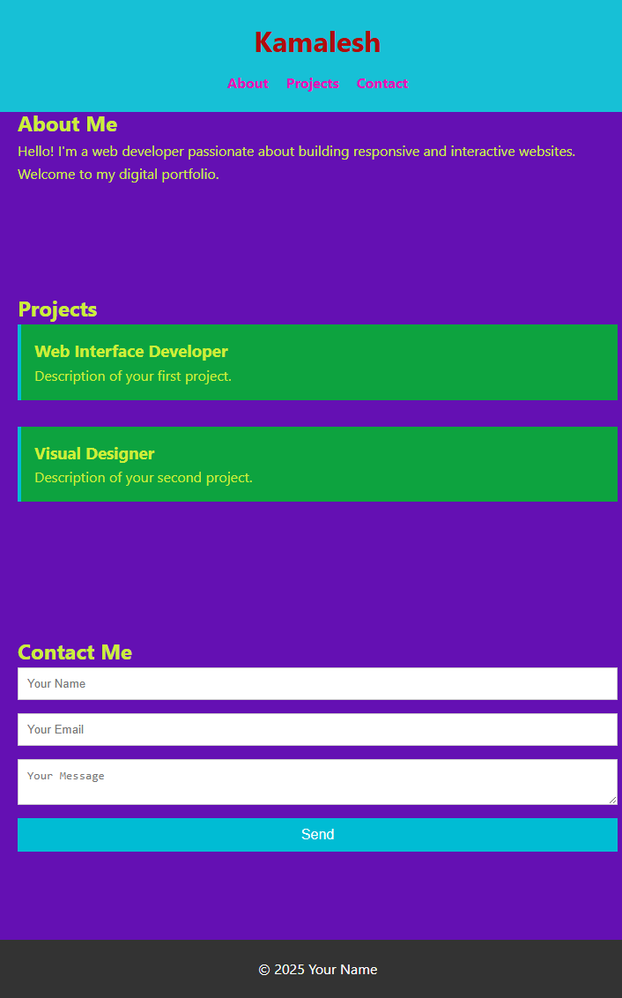
screenshots

Slide 14
Conclusion
This project highlights the importance of developing a user-friendly and efficient platform that meets the needs of its target users. By integrating essential features, clear design, and reliable functionality, the project demonstrates how technology can be applied to solve real-world problems effectively. Overall, the project serves as a strong foundation for future improvements, scalability, and innovation, ensuring that it continues to provide value to its end users.

Slide 15
Thank you

